Slide 1
Ethernet
CCNA Exploration Semester 1
Chapter 9

Slide 2
Ethernet
OSI model layers 1 (physical) and 2 (data link)
TCP/IP model Network Access layer
Application
Presentation
Application
Session
Transport
Transport
Network
Internet
Data link
Ethernet
Network Access
Physical

Slide 3
Ethernet
The most common LAN technology
Different media (copper cable, optical fibre)
Different bandwidths (10, 100Mbps, Gbps, +)
Same addressing scheme
Same basic frame format

Slide 4

Ethernet history
First LAN was Ethernet, designed at Xerox
1980 Ethernet standard published by DIX (Digital, Intel, Xerox)
1985 IEEE modified Ethernet standard and published as 802.3
802.2
LLC
MAC
Ethernet
802.3

Slide 5
Sublayers
Logical Link control sublayer links to upper layers, is independent of equipment.
Media Access Control sublayer provides addressing, frame format, error detection, CSMA/CD.
Physical layer handles bits, puts signals on the medium, detects signals.
LLC
MAC

Slide 6
Advantages of Ethernet
Simplicity and ease of maintenance
Ability to incorporate new technologies (e.g. fibre optic, higher bandwidths)
Reliability
Low cost of installation and upgrade

Slide 7
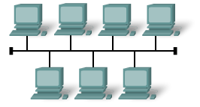
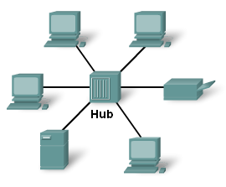
Shared medium
Physical bus topology
10Base5 (thick coaxial cable up to 500m)
10Base2 (thin coaxial cable up to 185m)
Physical star topology
10BaseT (UTP cable up to 100m)
Collisions happen – managed with CSMA/CD

Slide 8
Hubs and switches
“Legacy Ethernet”, 10Base5, 10Base2 or 10BaseT with hubs is designed to work with collisions, when devices transmit at the same time. Collisions are managed by CSMA/CD.
Performance is poor if there is a lot of traffic and therefore a lot of collisions.
Collisions can be avoided by using switches and full duplex operation.

Slide 9


Hubs and switches
Switch forwards frames only to the destination once the address is known.
Hub forwards frames through all ports except incoming port.

Slide 10
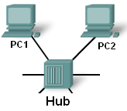
Half duplex
One-way traffic. Necessary on a shared medium.
If PC1 is transmitting but also detects incoming signals then there is a collision.

Slide 11
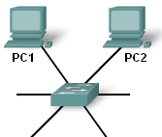
Full duplex
Two way traffic
PC can transmit and receive at the same time
Not on shared medium – must have dedicated link from switch
No collisions

Slide 12
Fast Ethernet, Gigabit Ethernet
Along with the move to switches came higher bandwidth: 100 Mbps or Fast Ethernet.
Later came 1000 Mbps, Gigabit Ethernet.
Gigabit Ethernet requires fully switched and full duplex operation. Collisions are no longer defined and cannot be managed.

Slide 13
LAN, MAN, WAN
Ethernet was developed for local area networks confined to a single building or group of buildings on one site.
Using fibre optics and Gigabit speeds, Ethernet can be used for Metropolitan Area Networks – throughout a town or city.
Ethernet can even be used over larger areas so the distinction between LAN and WAN is no longer clear.

Slide 14
Ethernet Frame
Packet from Network layer is encapsulated
Packet
Frame header
Packet
Trailer
Preamble
Start of frame delimiter
Destination address
Source
address
Length
/type
Packet
Data
Frame
Check
Seq.
7
1
6
6
2
46-1500
4
Field size in bytes. Preamble and SFD are not counted in frame size. Frame is 64-1518 (later 1522) bytes.

Slide 15
Frame fields
Preamble and start of frame delimiter: act as a wake-up call, help synchronisation, show where frame starts.
Destination Address: MAC address of destination, 6 bytes hold 12 hex digits.
Source Address: MAC address of sender, 6 bytes hold 12 hex digits.

Slide 16
Frame fields
Length/type field: DIX used this for type, the original IEEE 802.3 standard used it for length. The later IEEE standard allows it to be used for either.
A value less than 0x0600 hex (1536 decimal) is length. A greater value is the type, a code showing which higher layer protocol is in use.

Slide 17
Frame fields
Data field: This contains the layer 3 protocol data unit, usually an IP packet.
If the packet is less than 46 bytes then the field length is made up to 46 bytes with a “pad”.
The frame trailer contains the Frame Check Sequence field, used for the cyclic redundancy check to detect corrupt frames.

Slide 18
Ethernet MAC address
A unique identification for a device (or NIC).
Burned into the ROM but copied to RAM.
First 3 bytes identify the manufacturer (Organizationally Unique Identifier)
A device reads the destination MAC address to see if it should process the frame.
A switch reads the destination MAC address to see where it should forward the frame.

Slide 19
Writing a MAC address
The 12 hex digits are written in different ways
00-05-9A-3C-78-00
00:05:9A:3C:78:00
0005.9A3C.7800
This is the same address
00-05-9A is the manufacturer’s ID
assigned by IEEE
3C-78-00 is assigned by the manufacturer

Slide 20
Different addresses
MAC addresses are used to identify devices within a network. They are layer 2 addresses in the frame header.
IP addresses are used to pass data between networks. They are layer 3 addresses in the packet header. They identify the network as well as the device.

Slide 21
On a long journey…
The packet header with IP addresses is created by the source host and stays the same throughout the journey.
The frame header is stripped off and replaced by each router, so the MAC addresses are different for every step of the journey. If parts of the journey are not over Ethernet then there will be a different addressing system – not MAC.

Slide 22
Unicast, multicast, broadcast
Unicast: a message sent to one particular host. It must contain the destination host’s IP address and MAC address.
Broadcast: message for all hosts on a network. “Host” part of IP address is all binary 1s. E.g. 192.168.1.255 MAC address is all binary 1s, FF:FF:FF:FF:FF:FF in hex.
Multicast: message for a group of devices.
IP address 224.0.0.0 to 239.255.255.255

Slide 23
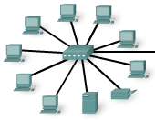
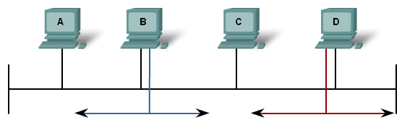
Collisions
Ethernet originally used shared coaxial cable.
If hosts transmit at the same time, there is a collision.
Later networks used hubs and UTP cable but the medium is still shared and collisions occur.

Slide 24
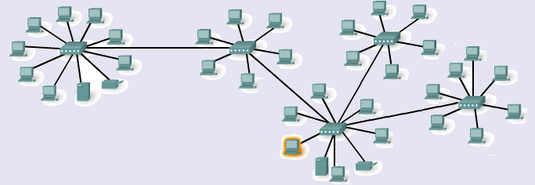
Hubs and Collision Domains
Collision domain – area where collisions occur.
Add more hubs and PCs – collision domain gets bigger, more traffic, more collisions.
Hosts connected by hubs share bandwidth.
Only one PC
can send

Slide 25
CSMA/CD
Carrier Sense: ‘Listen’ to see if there are signals on the cable
Multiple Access: Hosts share the same cable and all have access to it
Collision Detection: Detect and manage any collisions of signals when they occur
This is the ‘first come, first served’ method of letting hosts put signals on the medium

Slide 26

Listen for signals
Are there signals on the cable?
Yes.

Slide 27
Wait if there are signals
Wait until there are no more signals

Slide 28
Listen for signals
Are there signals on the cable now?
No.

Slide 29
Put signals on cable
Put my signals on the cable.

Slide 30
Listen for collisions: no
No collision.
All is well.
My message was sent.

Slide 31
Listen for collisions: yes
There is a collision.
Stop sending signals.
Send jamming signal.
My message is lost.

Slide 32
Listen again
No signals now.
Wait for a random length of time.
Send message again.

Slide 33

CSMA/CD
Collisions happen if a host transmits when there is a signal on the cable but the host does not yet know about it.
Latency is the time a signal takes to travel to the far end of a cable. The longer the cable and the more intermediate devices, the more latency.
All clear

Slide 34
CSMA/CD
If a host detects a collision while it is sending the first 64 bits of a frame then CSMA/CD works and the frame will get resent later.
If the host has sent 64 bits and then detects a collision, it is too late. It will not resend.
Latency must be small enough so that all collisions are detected in time.
This limits cable length and the number of intermediate devices.

Slide 35
Definitions
Latency or propagation delay: the time it takes for a signal to pass from source to destination.
Bit time: the time it takes for a device to put one bit on the cable. (Or for the receiving device to read it.)
Slot time: the time for a signal to travel to the far end of the largest allowed network and return.

Slide 36
Interframe spacing
The time between the end of one frame and the start of the next frame.
Gives the medium a chance to stabilise.
Gives devices time to process the frame.
Devices wait a minimum of 96 bit times after a frame has arrived before they can send.
9.6 microseconds for 10 Mbps Ethernet
0.96 microseconds for 100 Mbps Ethernet

Slide 37


Different bandwidths
Change from 10 Mbps to 100 Mbps
The sender puts the bits on the cable 10 times as fast, but they still travel at the same speed along the cable.
Collision detected at the same time as before.
Still sending frame
Frame gone – too late

Slide 38
So… for CSMA/CD to work
The greater the bandwidth, the closer a collision must be in order to detect it in time.
The greater the bandwidth, the shorter the possible cable length from one end of the collision domain to the other.
10 Mbps can have reasonable lengths.
100 Mbps can just manage 100 metres.
1 Gbps needs special arrangements
10 Gbps – not a chance. Can’t do collisions.

Slide 39
Get rid of collisions
Replace all hubs with switches.
Each device has a private cable and gets the full bandwidth.
Use full duplex on each link.
No collisions.
Can use higher bandwidths.

Slide 40
Legacy Ethernet
10 Base-T – 10 Mbps, uses UTP cables
Transmits on wires 1/2, Receives on 3/6
Uses Manchester encoding.
10 Base-2 and 10 Base-5 used coaxial cable. They are obsolete and are no longer recognised by the standards.

Slide 41
Fast Ethernet
100 Base-TX – 100 Mbps, uses UTP cables
Transmits on wires 1/2, Receives on 3/6
Uses 4B/5B encoding
100 Base-FX – 100 Mbps, uses multimode fibre optic cables.

Slide 42
Gigabit Ethernet
1000 base-T – 1Gbps uses UTP cables. Uses all 4 wire pairs, transmitting and receiving at the same time on the same wire.
Complex encoding and detection system.
1000 Base-SX – uses multimode fibre, shorter wavelength.
1000 Base-LX – uses single or multimode fibre, longer wavelength.

Slide 43
10 Gbps Ethernet
Still evolving
Potential for operating over longer distances – MANs and WANs
Still uses same basic frame format as other Ethernet versions.
Higher bandwidths are planned.

Slide 44
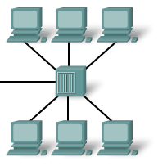
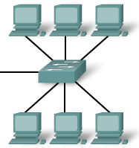
Hub and Switch
Shared medium
Shared bandwidth
Collisions
Point to point links
Dedicated bandwidth
Use full duplex – no collisions
Hub
Switch

Slide 45
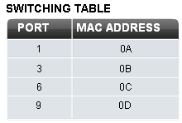
Switching table
Switch builds a switching table matching its port numbers to the MAC addresses of devices connected to them.
When a frame arrives, it reads the destination MAC address, looks it up in the table, finds the right port and forwards the frame.

Slide 46
Flooding
If the switch does not find the destination address in its table then it floods the frame through all ports except the incoming port.
Broadcast messages are flooded.

Slide 47
Learning addresses
The switch learns addresses by looking at the source MAC address of an incoming frame.
It then matches the address to the port where the frame came in and puts the information in its table.
Entries are time stamped and removed from the table when the time runs out.
They can be refreshed when another frame comes in from the same host.

Slide 48
ARP table
A host wants to send a message.
It knows the destination IP address and puts it in the packet header.
It looks in its ARP table and finds the corresponding MAC address.
It puts the MAC address in the frame header.

Slide 49
Address resolution protocol
A host wants to send a message.
It knows the destination IP address.
The destination MAC address is not in its ARP table.
Host broadcasts “Calling 192.168.1.7, what is your MAC address?”
192.168.1.7 replies “My MAC address is…”
Host sends message and updates ARP table.

Slide 50
Remote addresses
Host can see that destination IP address is on another network
It finds the IP address of the default gateway
It sends an ARP request for the matching MAC address of the default gateway
Default gateway router replies and gives its own MAC address
Host sends message via router and updates ARP table.

Slide 51
Proxy ARP
If a host cannot tell that the destination IP address is on another network, it will send an ARP request asking for the matching MAC address
The router will reply, giving its own MAC address
The host will send the message via the router

Slide 52
The End

